Slide 1

DOSRI: AMPLIFYING SOCIALLY RESPONSIBLE INVESTING (SRI) PRESENTATION 5
Team 1: Six Underground
Presented by:
Jephthe Louis-Jacques
Harshal Patil
Samarth Yadav
Kush Shah
Farhan Pasha Mohammed
Naga Sai Kiran Nimmakayala
Instructor:
Professor Henry Wong
Notes:
Kush

Slide 2




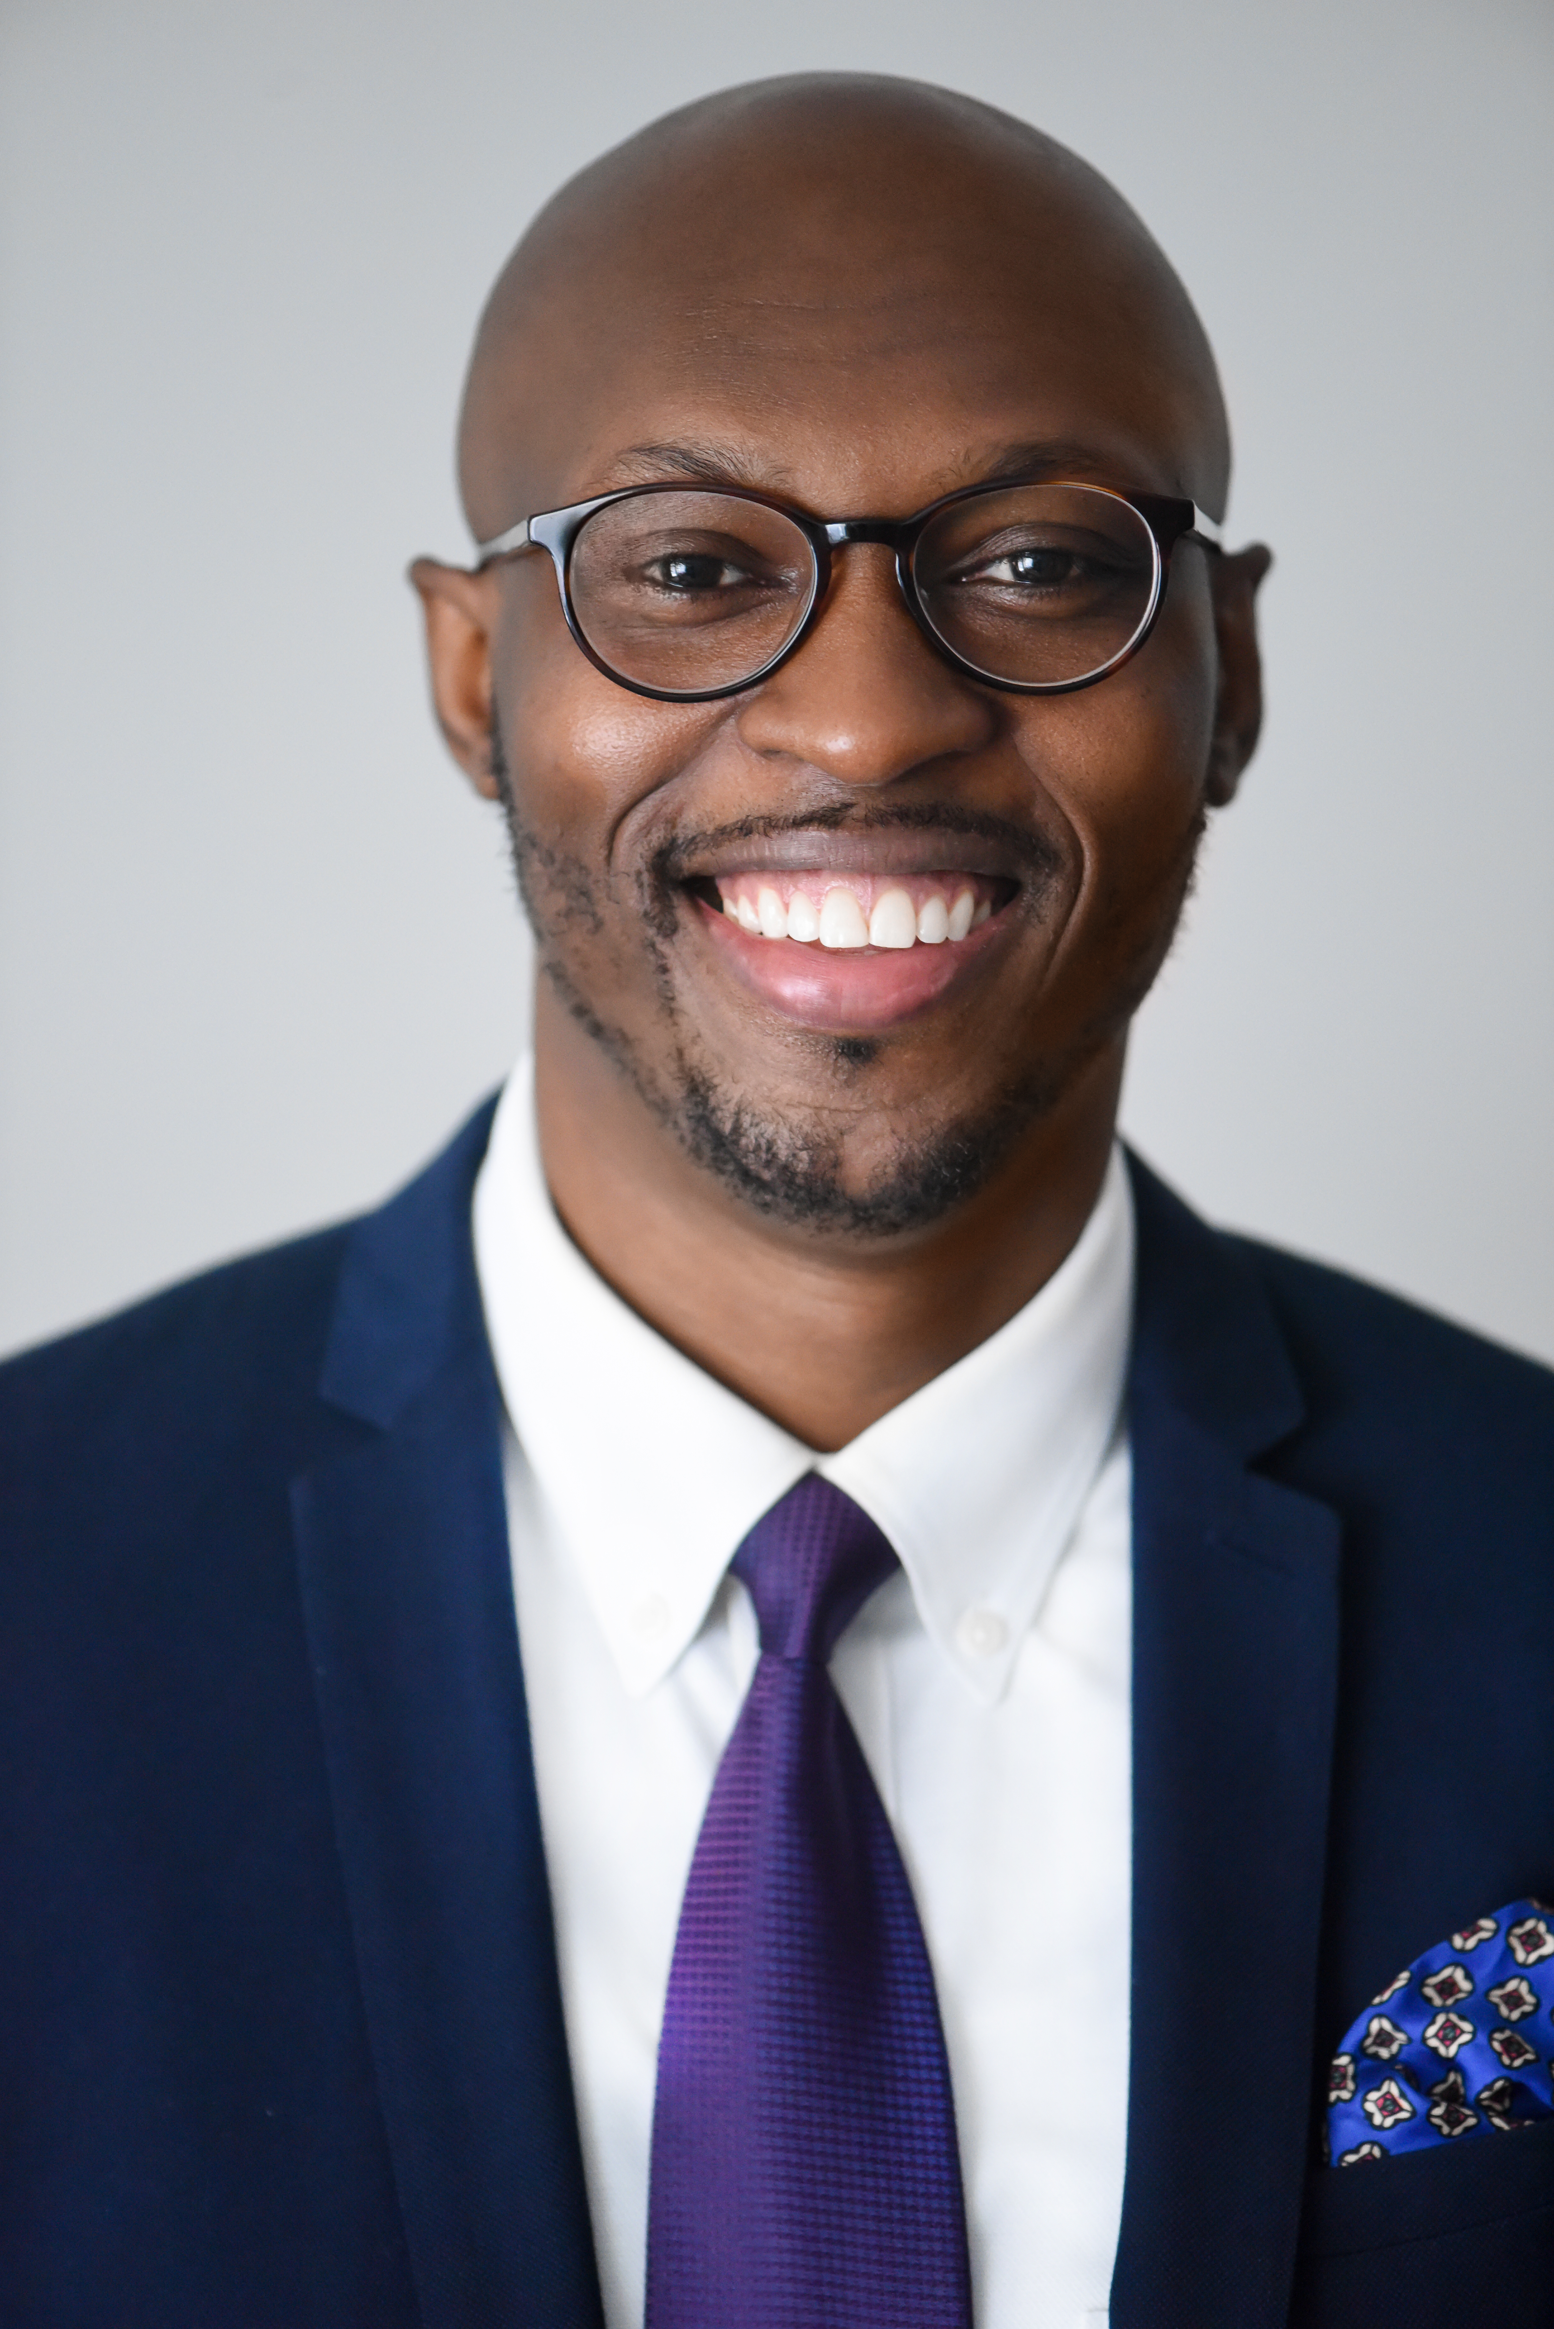

Team Members
Farhan Pasha Mohammed
Naga Sai Kiran Nimmakayala
Jephthe Louis-Jacques
Harshal Patil
Samarth Yadav
Kush Shah
Project Manager
Developer
QA Analyst
Developer
Cloud Engineer
Tester

Slide 3
AGENDA
1. Project Overview
2. Personas
3. Looking forward this semester
4. Sprint 4 vs Sprint 5
5. Sprint 5
6. Demo
7. Product Backlog
8. Retrospective

Slide 4
PROJECT OVERVIEW

Slide 5
WHAT IS DOSRI?
“Dosri” is a free website that provides investors insight about publicly traded companies social rating base on the ‘Environmental, Social, & Governance’ (ESG) standard rating.
Provides investors with latest stock price, stock price and third-party brokerages accounts for creating investment accounts if interested in buying the stock
The differentiator with the site is to amplify Socially responsible investing amongst investors by quickly helping them identify companies that are sustainable, particularly in the three categories below:
Environmental - Issues such as climate change and pollution
Social - Issues around workplace practices and human capital
Governance - Issues such as executive pay, accounting, and ethics
DO Socially Responsible Investing (DOSRI)

Slide 6
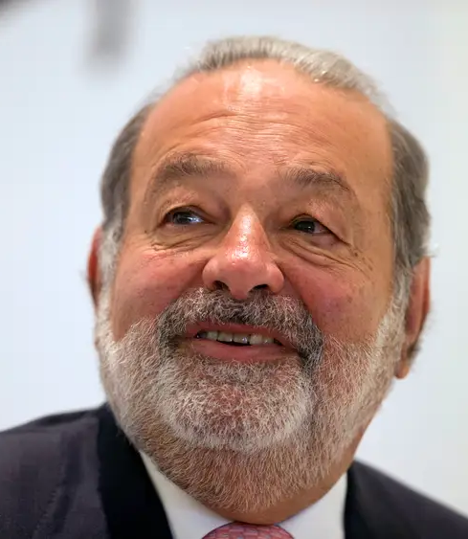
PERSONA 1: CARLOS, PUBLIC SPEAKER
Background Profile:
Carlos, a 60 years old, wealthy long-term investors that does financial public speaking, runs his own family office, always looking for new tools to make better investment decisions
Carlos likes to research companies and read the latest stories about them to quickly identify their long-term financial positions
How Dosri can help?
Carlos can search various publicly traded companies on Dosri and review their financials.
Dosri simultaneously provides google articles related to the searched company for additional insight on performance.
Carlos can search companies on Dosri to gather metrics to better inform his audience of the top performing ESG companies.
Notes:
Kush

Slide 7

PERSONA 2: DONNA, RECENT GRADUATE
Background Profile:
Donna, a 24 years old, recent college graduate that major in product design, currently making 120K USD, identifies as a vegan and cares about the environment.
She sees the value of investing her dispensable money, but she is new to the finance and conscious of companies that are known for conducting unethical practices.
How Dosri can help?
Donna can search various publicly traded companies on Dosri and review their financials.
Dosri simultaneously provides google articles related to the searched company for additional insight on performance.
If Donna is ready to make an investment, Dosri provides quick access links to investment brokerages at real time.

Slide 8
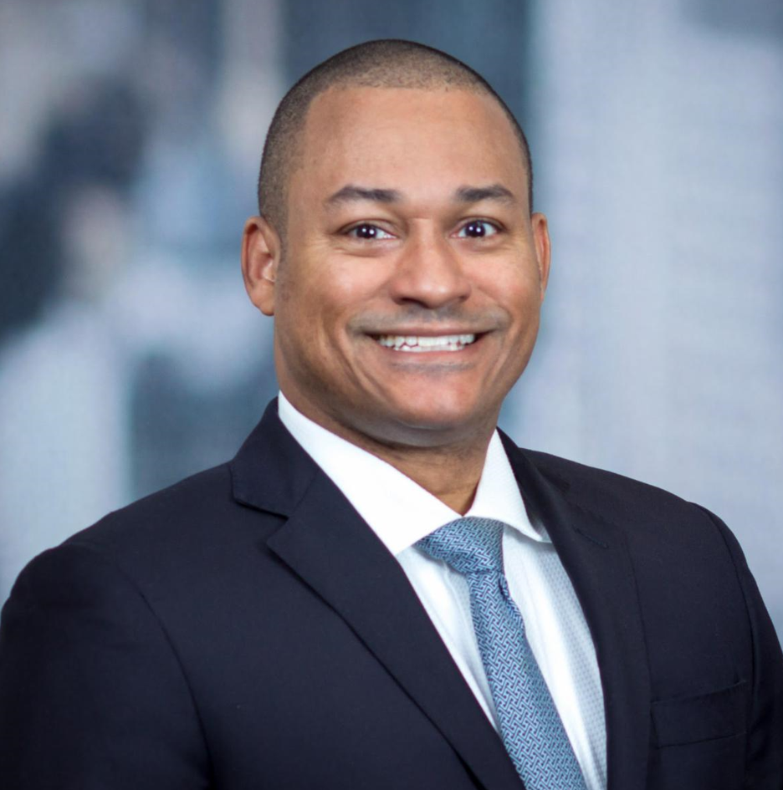
PERSONA 3: PAUL, INVESTOR
Background Profile:
Paul, 26 years old, a recent college graduate working as an investment advisor at a Bank, is aiming to bring more value himself to the Bank and all the customers.
His thinking is not only are investments in socially responsible assets vastly growing. The market shows that this interest stems to a significant extent from investors trying to align their investments with their social preferences.
How Dosri can help?
Dosri helps Paul as he can review SR companies with a sustainable business plan and can get more accurate information for investment.
Dosri helps provide insights into the company’s financial growth with user friendly UI.
As Paul is completes his review process; Dosri provides quick links to investment brokerages in real-time.
Notes:
In other words, these investors really want to invest in SRI because of its social impact.

Slide 9
MVP
User can enter company name in search bar, Search bar detects and gives automatic recommendation of a company name before entering full details
Once the company name is entered user should be able to click submit button , Resulted ESG Data is displayed in Tabular forms
Environmental score of a particular company will be displayed individually apart from ESG total rating, Company's information is displayed and it shows along with the environmental score
Environmental, social and governance total ESG score to determine corporate sustainability , Resulted ESG Data is displayed in Tabular forms
Historical data of a company is also available in DOSRI website, Data is returned in Tabular form.
Notes:
samarth

Slide 10
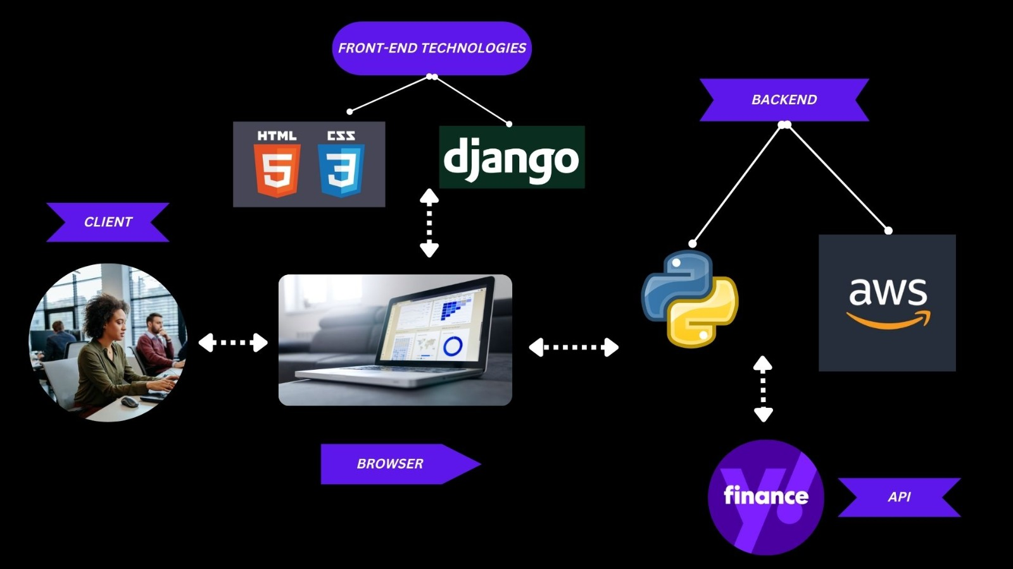
Architecture Design

Slide 11

LOOKING FORWARD INTO THE SEMESTER
This semester our team is considering enhancing our product roadmap with various features that will expand our offers. We are considering:
Login + Password UI/UX for savings searches
Visualization tools for metrics
Database for storing user data
Implement AWS & MySQL DB
Notes:
samath

Slide 12
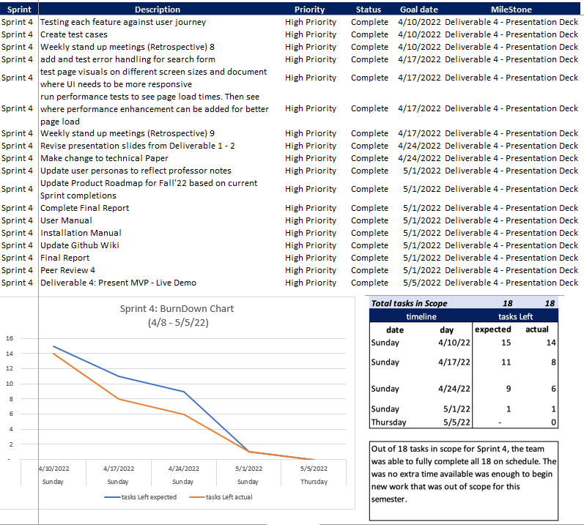
SPRINT 4: COMMITTED TASKS AND STORIES
Notes:
Farhan

Slide 13
SPRINT 4 VS SPRINT 5

Slide 14
COMPARISON
Sprint 4
We implemented front end UI
Didn’t complete CSS/HTML
We implemented Yahoo Finance API
Create search bar function against API to call financial data related to specific company selected in the search bar
We data grid to present historical data from API for the selected company
Begun designing UI/UX
Sprint 5
Completed front end UI with CSS/HTML
Continuous work in progress
Researched backend for implementing new features that require RDS (i.e., AWS)
We included data metrics in dynamic visualization tools i.e., Graph
Notes:
Farhan

Slide 15


NEW TECHNOLOGIES:
HTML/CSS – Sprint 5
CSS stands for Cascading Style Sheets. CSS describes how HTML elements are to be displayed on screen, paper, or in other media. CSS saves a lot of work. It can control the layout of multiple web pages all at once. External stylesheets are stored in CSS files.
AWS - TBD
Amazon Web Services, Inc. is a subsidiary of Amazon that provides on-demand cloud computing platforms and APIs to individuals, companies, and governments, on a metered pay-as-you-go basis.
Notes:
Fahan

Slide 16
SPRINT 5
Notes:
Jeff

Slide 17
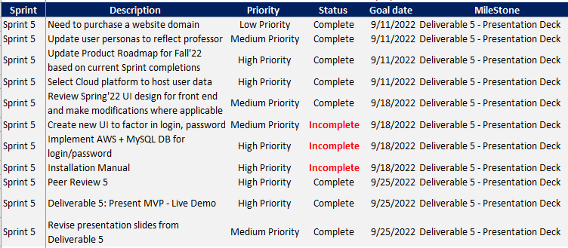
SPRINT 5: COMMITTED TASKS AND STORIES
We’re currently at a 12.6% velocity in Sprint 5. Looking to improve on our Rate by being more precise on what we think we can finish within a sprint by considering holidays, fixing bugs etc.

Slide 18
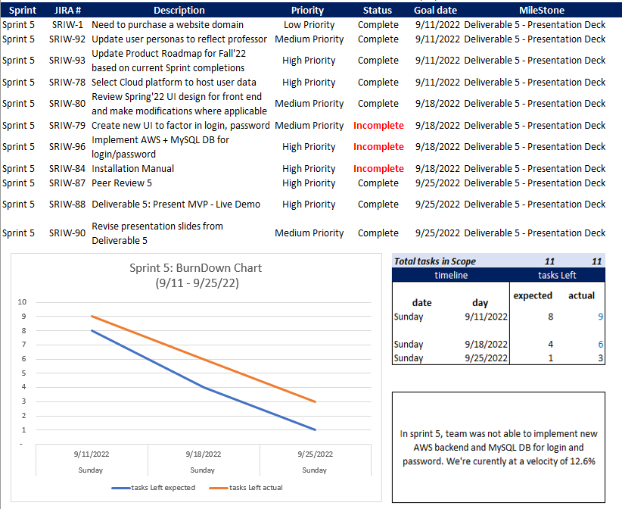
SPRINT 5: BURNDOWN CHART
Notes:
Jeff

Slide 19
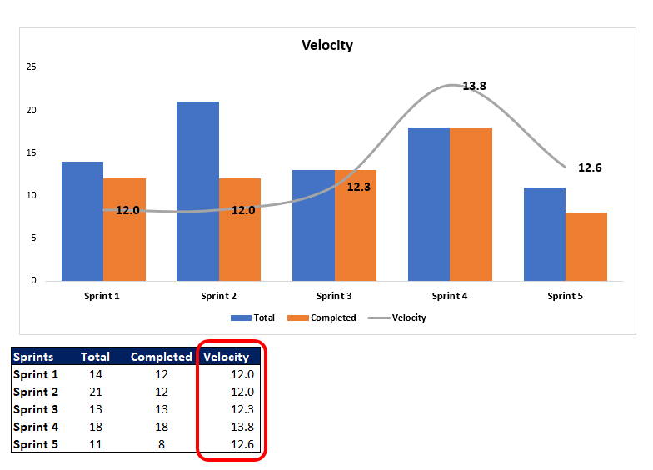
Velocity :
We’re currently at a 12.6% velocity in Sprint 5. Looking to improve on our Rate by being more precise on what we think we can finish within a sprint by considering holidays, fixing bugs etc.
Notes:
Jeff

Slide 20
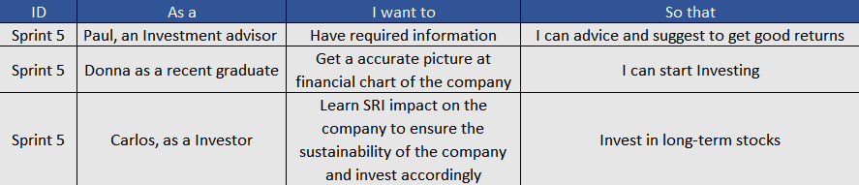
SPRINT 5: USER STORIES & ACCEPTANCE CRITERIA
Notes:
Jeff

Slide 21
PROJECT DEMO

Slide 22
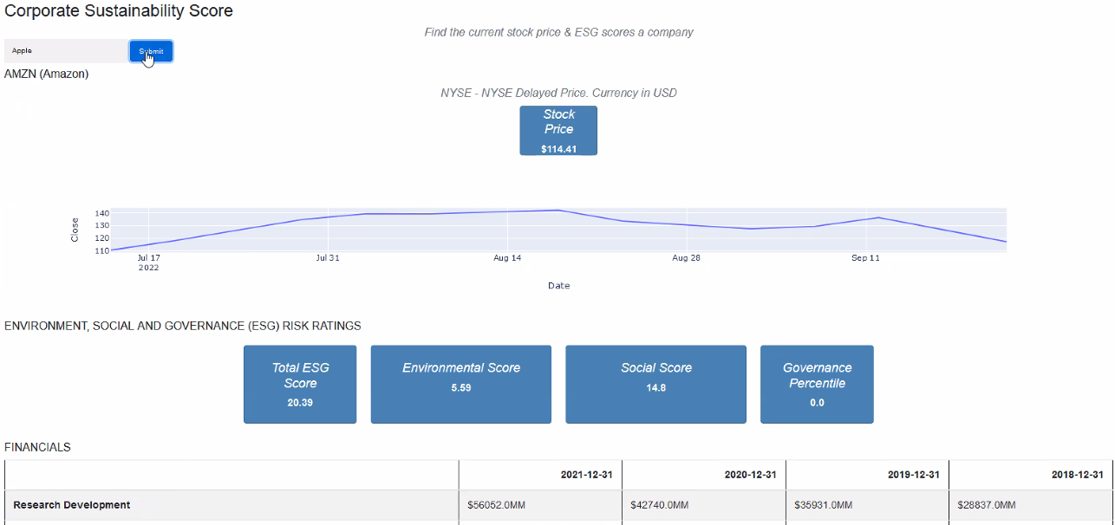
DEMO OF NEW CAPABILITIES
Notes:
Harshal

Slide 23
PRODUCT BACKLOG

Slide 24
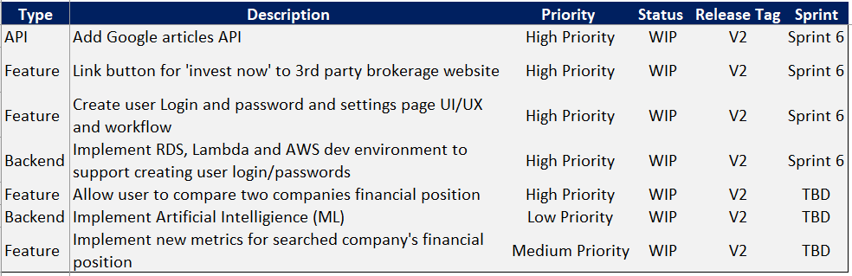
PRODUCT BACKLOG
Notes:
Harshal

Slide 25
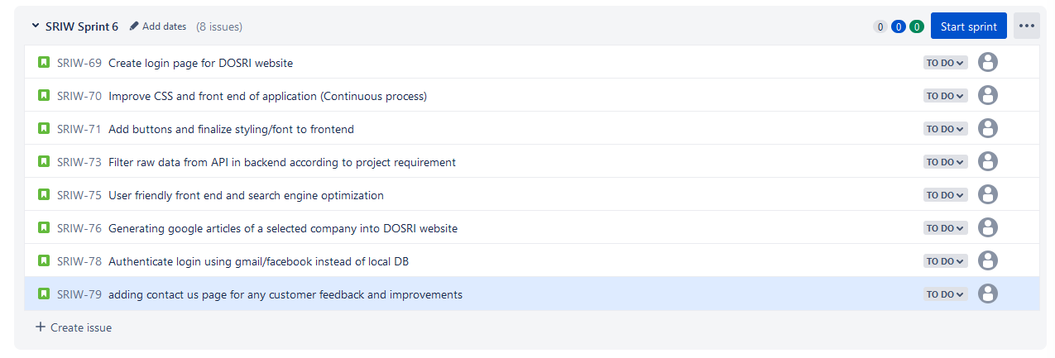
SPRINT 6 STORIES IN SCOPE
Notes:
Kiran

Slide 26
RETROSPECTIVES

Slide 27
What went well
Team collaborative effort to make major changes to presentation
Group meetings multiple times a week to make sure roadblocks are identified and addressed in a timely fashion
What needs improvement
Timelines for executing stories in scope for current sprints need to be enforced to avoid mid sprint changes
Improving our product roadmap by priority and dates
Next Step
Need to read documentation for AWS deployment
Need to consider workflow and design for login and password interface
Notes:
Kiran

Slide 28
THANK YOU!

